Slide 1
Naïve Bayes Classifier Algorithm

Slide 2
Contents
Overview
Types of Machine Learning Classification algorithm
Introduction to Naïve Bayes
Bayes’ Theorem with mathematical expressions
Assumptions and working of Naïve Bayes
Types of Naïve Bayes
Python implementation
Advantages and disadvantages
Applications and how Naïve bayes is better than other algorithms
Conclusion
References

Slide 3
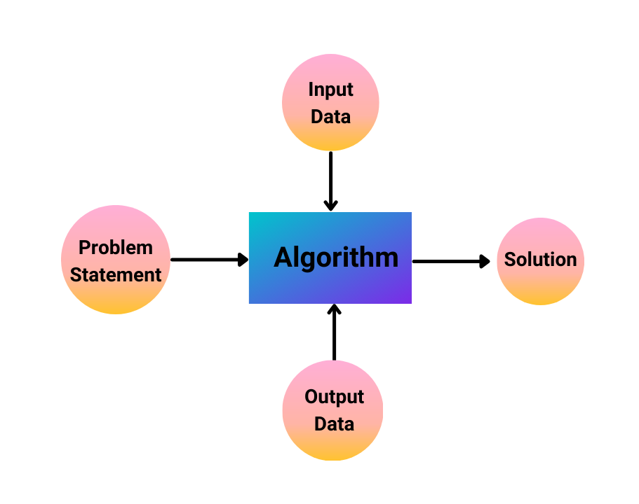
Overview
Classification of Machine Learning Models
It depends upon the nature of five components
1. Nature of Input data
2. Nature of Problem
3. Nature of Algorithm
4. Nature of Output data and
5. Nature of Solution

Slide 4
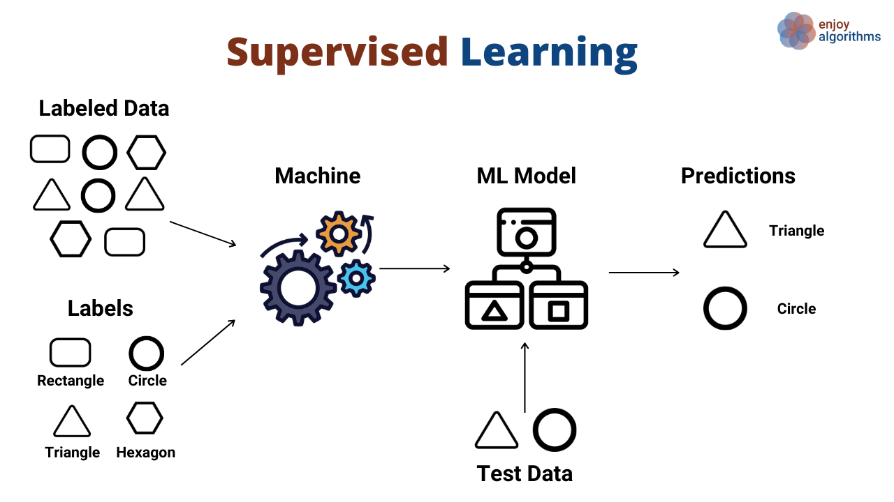
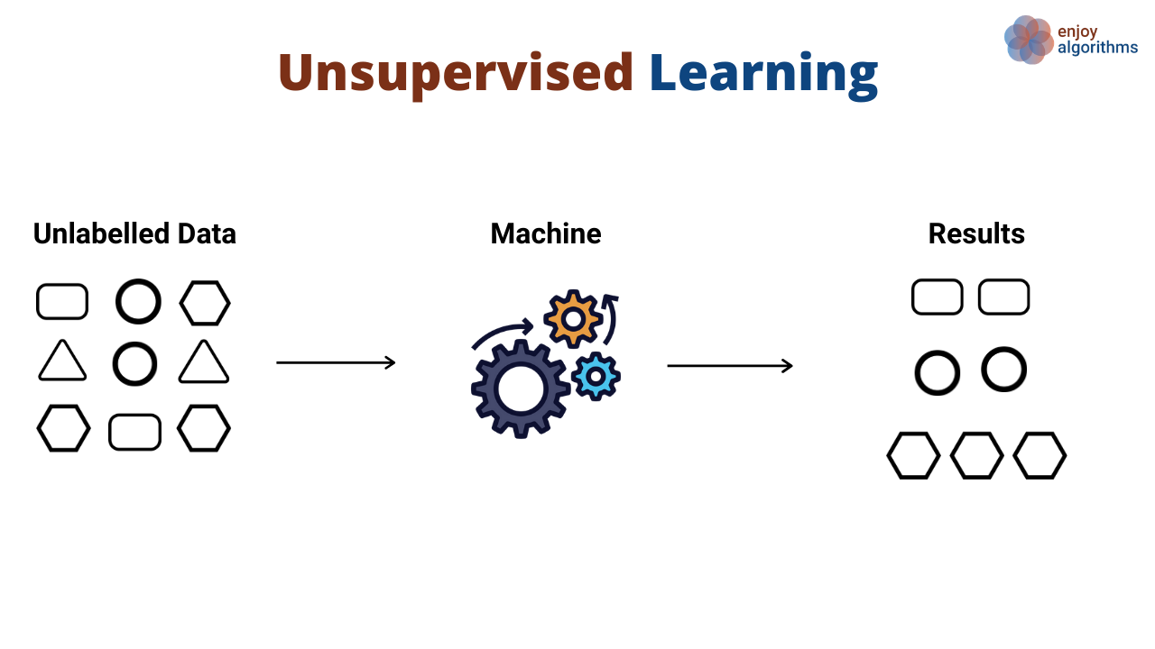
Models are trained using labelled data
Models need to find the mapping function to map input variable (x) with output variable (y)
i.e., y = f(x)
More accurate results
Patterns inferred from unlabelled input data
No explicit output data is required
Less accurate results

Slide 5
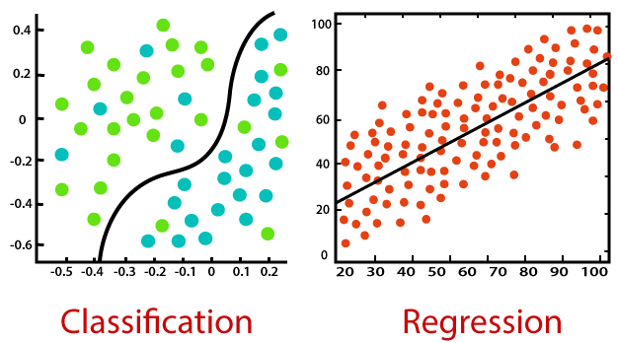
Classification:
Process of finding a function which helps in dividing the dataset into classes based on different parameters
Predict discrete values such as male/female, true/false, spam/not spam
Eg. Email spam detection
Regression:
Process of finding the correlations between dependent and independent variables
Find the best fit line, which can predict the output more accurately
Predict continuous values such as price, salary
Eg: predicting market trends, house prices

Slide 6
Types of Machine Learning Classification Algorithm:
Logistic Regression
K-Nearest Neighbors
Support Vector Machine
Kernel SVM
Naïve Bayes
Decision Tree Classification
Random Forest Classification

Slide 7
Naïve Bayes
Why is it called Naïve Bayes?
Naïve: It assumes that occurrence of certain feature is independent of occurrence of other features
Bayes: It depends on principle of Bayes’ theorem
Introduction:
It is based on Bayes’ theorem
It is one of the simple and most effective classification algorithms which helps in building fast machine learning models that can make quick predictions
It is probabilistic classifier, which means it predicts on basis of probability of an object
Example: Spam filtration

Slide 8
Bayes’ Theorem
According to Bayes’ theorem, probability of an event is described in terms of prior knowledge or given conditions that are related
Bayes’ theorem builds upon probability and conditional probability
Probability means likelihood of an event to occur and always takes a value between 0 and 1
Let an event be A,
Probability of an event A is denoted as,
Example: Roll dice
P(A) = (Number of desired outcomes) / (Number of total outcomes)

Slide 9
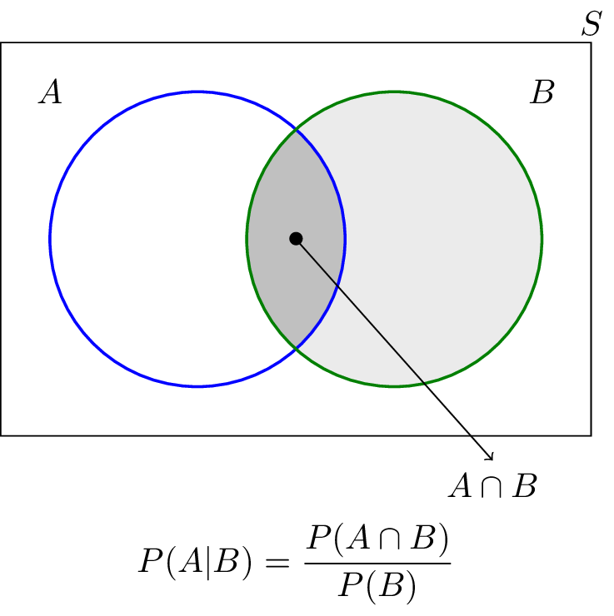
b) Conditional Probability means occurrence of any event A when another event B in relation to A has already occurred is known as conditional probability. It is depicted by P(A|B).
Let A and B be two events,
When the intersection of two events take place, then the conditional probability is given as,
Where,
P(A|B) represents the probability of occurrence of A given B
has occurred
P(A ∩ B) represents the probability of both events A and B
occurred together
P(B) represents the probability of event B

Slide 10
* Joint Probability
Joint Probability means the probability of the union or intersection of multiple events occurring.
It is denoted as P(A and B)
For independent events, Joint probability is
For dependent events, Joint probability is
P(A and B) = P(A) . P(B)
Example: Roll a die and flip a coin
1
P(A and B) = P(A) . P(B|A)
Example: Picking two cards from same deck
2

Slide 11
Joint probability is commutative for any 2 events
i.e.,
we know that; P(A and B) = P(A) . P(B|A)
and; P(B and A) = P(B) . P(A|B)
from equation 3, we get; P(A) . P(B|A) = P(B) . P(A|B)
dividing the above equation by P(B); we get the equation representing Bayes’ theorem as,
P(A and B) = P(B and A)
3
P(A|B) = [P(A) . P(B|A)] / P(B)

Slide 12
Naïve Bayes Classifier Algorithm Assumptions:
Features are independent of each other
i.e., No correlation between features
2. Consider all features contribute equally to the outcome
Working of Naïve Bayes Classifier:
Steps to be followed to solve given problem are:
Convert the given dataset into frequency tables.
Generate Likelihood table by finding the probabilities of given features.
Use Bayes theorem to calculate the posterior probability.
Problem statement: Suppose we have a dataset of weather conditions and corresponding target variable "Play". So using this dataset we need to decide that whether we should play or not on a particular day according to the weather conditions.
Problem: If the weather is sunny, then the Player should play or not?
Solution: To solve this, first consider the below dataset:

Slide 13
Weather |  | Play
0 | Rainy | Yes
1 | Sunny | Yes
2 | Overcast | Yes
3 | Overcast | Yes
4 | Sunny | No
5 | Rainy | Yes
6 | Sunny | Yes
7 | Overcast | Yes
8 | Rainy | No
9 | Sunny | No
10 | Sunny | Yes
11 | Rainy | No
12 | Overcast | Yes
13 | Overcast | Yes

Slide 14
Frequency table
Likelihood table
Weather | Yes | No
Overcast | 5 | 0
Rainy | 2 | 2
Sunny | 3 | 2
Total | 10 | 4
Weather | No | Yes
Overcast | 0 | 5 | (5/14)=0.35
Rainy | 2 | 2 | (4/14)=0.29
Sunny | 2 | 3 | (5/14)=0.35
All | (4/14)=0.29 | (10/14)=0.7
Now, applying Bayes’ theorem;
P(Yes|Sunny) = P(Sunny|Yes) * P(Yes)/P(Sunny)
P(Sunny|Yes) = 3/10 = 0.3

Slide 15
P(Sunny) = 0.35
P(Yes) =0.71
So P(Yes|Sunny) = 0.3 * (0.71 / 0.35) = 0.60
Also,
P(No|Sunny) = P(Sunny|No) * P(No)/P(Sunny)
P(Sunny|NO) = (2/4) = 0.5
P(No) = 0.29
P(Sunny) = 0.35
So, P(No|Sunny) = 0.5 * (0.29 / 0.35) = 0.41
So as we can see from the above calculation that P(Yes|Sunny) > P(No|Sunny)
Hence on a Sunny day, Player can play the game.

Slide 16
Types of Naïve Bayes Classifier Algorithm
Naïve Bayes Classifier Algorithm
Gaussian
Multinomial
Bernoulli

Slide 17
Bernoulli Naïve Bayes
Used for features with binary values like true/false, 0/1
Models features using Bernoulli distribution
Example: Detect whether a person has a disease or not
Let there be a random variable ‘X’ and let the probability of success be denoted by ‘p’ and the likelihood of failure be represented by ‘q’
Success: p and Failure: q
q = 1 – (probability of success)
q = 1 – p
p(x) = P[X=x] = q = 1-p x = 0
p x = 1
X = 1 Bernoulli trial = S
0 Bernoulli trial = F

Slide 18
Multinomial Naïve Bayes
Used for features with discrete values like word count 1,2,3...
Models features using Multinomial distribution
Example: Movie ratings (ranging 1 & 5, as each rating will have certain frequency to represent)
If the feature vectors have n elements and each of them can assume k different values with probability pk, then:
P(X₁ = x₁ ∩ X₂ … ∩ X_{k} = x_{k} ) = [ n! / Π_{i} x_{i} ! ] Π(p_{i} ^{xi} )

Slide 19
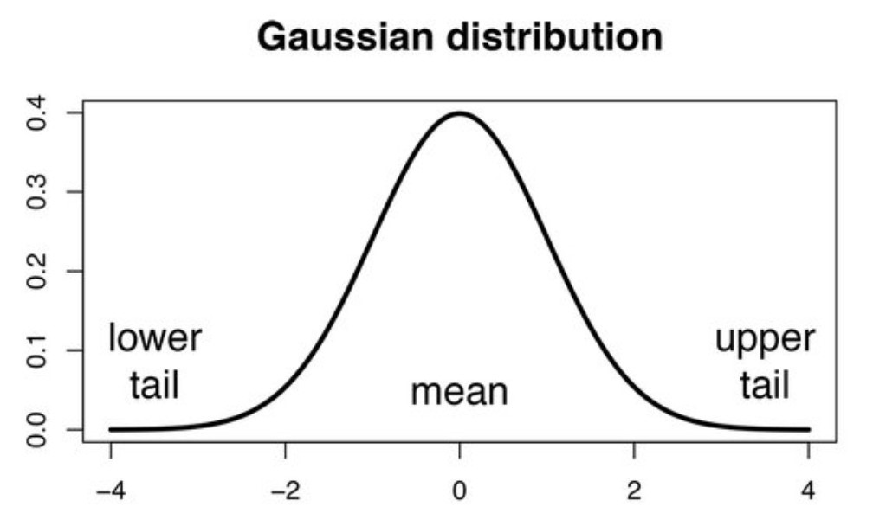
Gaussian Naïve Bayes
Used for features with continuous values
Models features using Gaussian(Normal) distribution
Example: Text classification
Gaussian Naïve Bayes algorithm expressed as
Where σ and µ are variance and mean respectively
X and Y are variables
c is a class
P(X|Y = c) = [ 1 / √2πσ_{c}² ] * [e * exp(-(x-µ)^2) / (2σ_{c}²)]

Slide 20
Python Implementation of Naïve Bayes Classification
Steps:
Data pre-processing
Fitting Naïve Bayes to training data
Predicting test result
Test accuracy of result
Visualizing test set result

Slide 21
Advantages and Disadvantages of Naïve Bayes Classification
Advantages:
1. Fast and simple algorithm to predict class of algorithms
2. Used for both binary and multi class
3. Performs well in multi class predictions as compared to other algorithms
4. Most popular choice for text classification problems
5. Used for real-time predictions, as it is an eager learner
Disadvantages:
1. Cannot learn relationship between features 2. Its estimations can be wrong in some cases 3. This algorithm faces the ‘zero-frequency problem’

Slide 22
Zero-Frequency Problem:
If an individual class label is missing, then the frequency-based probability estimate will be zero. And we will get a zero when all the probabilities are multiplied.
To avoid this problem, we use Laplace Smoothing
Laplace Smoothing:
Laplace smoothing is a smoothing technique that handles the problem of zero probability in Naïve Bayes.
From the weather example considered above,
Where ‘k’ represents the smoothing parameter
‘X’ represents number of features in the data
P_{LAP,k}(weather = overcast|No) = [ P(weather = overcast|No) + k ] / [ P(No) + (k*X) ]

Slide 23
Applications of Naïve Bayes Classification
Spam filtering
Credit scoring
Medical data classification
Sentiment analysis
Recommender systems
How is Naïve Bayes Classification Algorithm better than other algorithms?
It does not require more training data
It handles both discrete and continuous data
It is highly scalable with number of predictors and data points
Faster
Preferred for real-time predictions as it is eager learner

Slide 24
Conclusion
Training is very fast and easy
It is fast and easy to implement but their biggest disadvantage is that, the requirement of predictors to be independent.
It has many successful applications
Uses Laplace Smoothing to avoid Zero-frequency problem
In most of the real life cases, the predictors are dependent, this hinders the performance of the classifier.

Slide 25
References:
https://www.javatpoint.com/machine-learning-naive-bayes-classifier
https://machinelearningmastery.com/bayes-theorem-for-machine-learning/
https://medium.com/analytics-vidhya/na%C3%AFve-bayes-algorithm-5bf31e9032a2#:~:text=What%20is%20Na%C3%AFve%20Bayes%20Algorithm,one%20with%20the%20highest%20probability.
https://www.i2tutorials.com/what-is-the-difference-between-gaussian-multinomial-and-bernoulli-naive-bayes-classifiers/
https://www.mygreatlearning.com/blog/multinomial-naive-bayes-explained/
https://www.upgrad.com/blog/naive-bayes-explained/
https://www.enjoyalgorithms.com/blog/classification-of-machine-learning-models

Slide 26


